Slide 1
Rate my Tweet: Comparative Judgement in the Wild
Andy Gray
CDT Cohort 2: MSc Project

Slide 2
Overview
Motivation
Background
Methodology
Implementation
Results
Conclusion

Slide 3


Motivation
Is to create a tool for educators that will empower them.
Allowing the technology to do what it is good at and aiding the teachers in their decision making to allow the teachers to focus on what they are good at.
creating and delivering lessons, to shape future generations.

Slide 4
Overview
Motivation
Background
Methodology
Implementation
Results
Conclusion

Slide 5

Background
Within our project there was 3 main focus areas:
The role of Marking and Feedback within Teaching and Learning
Comparative Judgement
Other Types of Ranking Systems

Slide 6


Background – Marking and Feedback
Educators conducting marking and feedback provides multiple benefits:
A means to assess students attainment levels
Diagnostic
Formative – Assessment for Learning (AfL)
Summative – Assessment of Learning (AoL)
The ability to rank students
To provide feedback
There are also multiple drawbacks:
The feedback is only helpful if the students get a chance to act on it
Marking creates a huge cognitive load
Marking is hard for the teacher to remain unbiased
Marking requires a lot of time to conduct
Notes:
A means to assess students attainment levels
Diagnostic
Formative – Assessment for Learning (AfL)
Summative – Assessment of Learning (AoL)
To provide feedback
To empower the students
With information on what they done well
With what they can improve on

Slide 7


Background – Comparative Judgement
Introduced in 1927 By Louis Leon Thurstone – A Psychologist
Requires a pairwise comparison of all unique combinations
In the educational space Adaptive Comparative Judgement (ACJ) has been adopted
Has very high accuracy rates
Although ACJ provided some benefits, it does have multiple flaws:
Increased work load
No personalised feedback provided
It causes bias within the results
Result accuracy is not much different to just random pairings

Slide 8

Background – Other Ranking Systems
Elo
Created by Arpad Elo in the 1960s
Introduced in the USCF is its method of ranking in the 1980s
It does have some flaws:
protecting one’s rating,
selective pairing
ratings inflation and deflation
Glicko
Created by Mark Glickman
It worked similar to the Elo system but addressed many of Elo’s flaws
This was through using a RD measure, which increases over time with inactivity
Notes:
Used in multiple scenarios from esports to traditional sports like football, American football and basketball
It does have some flaws:
protecting one’s rating,
selective pairing
ratings inflation and deflation.

Slide 9
Overview
Motivation
Background
Methodology
Implementation
Results
Conclusion

Slide 10


Methodology – Overall Aim
Cognitive Load
Work Load

Slide 11








Methodology – Overall Aim

Slide 12

Methodology – Tweets
An Englishman, a Scotsman and an Irishman walk into a bar. The Englishman wanted to go so they all had to leave. #Brexitjokes"
Why do we need any colour passport? We should just be able to shout, “British! Less of your nonsense!” and stroll straight through.
Q: With Britain leaving the EU how much space was created? A: Exactly 1GB"
VOTERS: we want to give a boat a ridiculous name UK: no VOTERS: we want to break up the EU and trash the world economy UK: fine"
#BrexitJokes How did the Brexit chicken cross the road? "I never said there was a road. Or a chicken".
After #brexit, when rapper 50 cent performs in GBR he'll appear as 10.00 pounds. #brexitjokes
I long for the simpler days when #Brexit was just a term for leaving brunch early.
Say goodbye to croissants, people. Delicious croissants. We're stuck with crumpets FOREVER.
Hello, I am from Britain, you know, the one that got tricked by a bus"
How many Brexiteers does it take to change a light bulb? None, they are all walked out because they didn’t like the way the electrician did it.

Slide 13
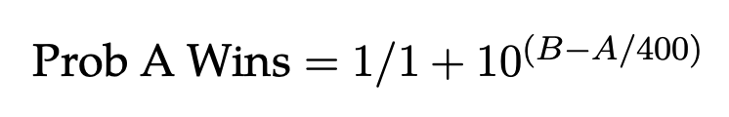
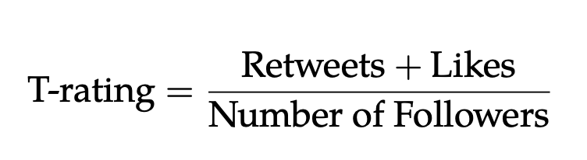
Methodology – Ranking Systems
Elo
The first step looks into the probability that A win (This is the expected score)
This generates the new Elo ranking score.
Rating = the players current Elo score
If a player wins the score = 1
If a player loses the score = 0
CJ Score
Wins – Loses
T-ranking Score
)
(
)

Slide 14

Methodology – NLP Techniques
Information Extraction
Part of Speech (POS) Tagging
Named Entity Recognition (NER)
Feature Extraction
Sentiment Analysis
Text Similarity
Utterance Pattern Matching
Finding Word Sequence Patterns
Key Phrases

Slide 15
Overview
Motivation
Background
Methodology
Implementation
Results
Conclusion

Slide 16
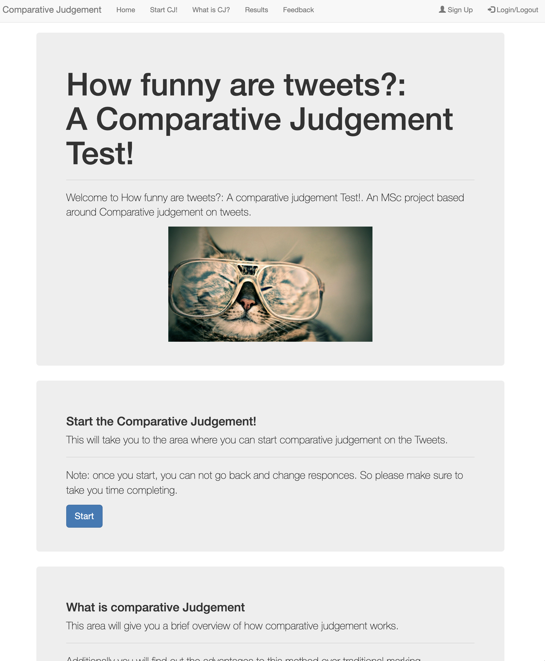
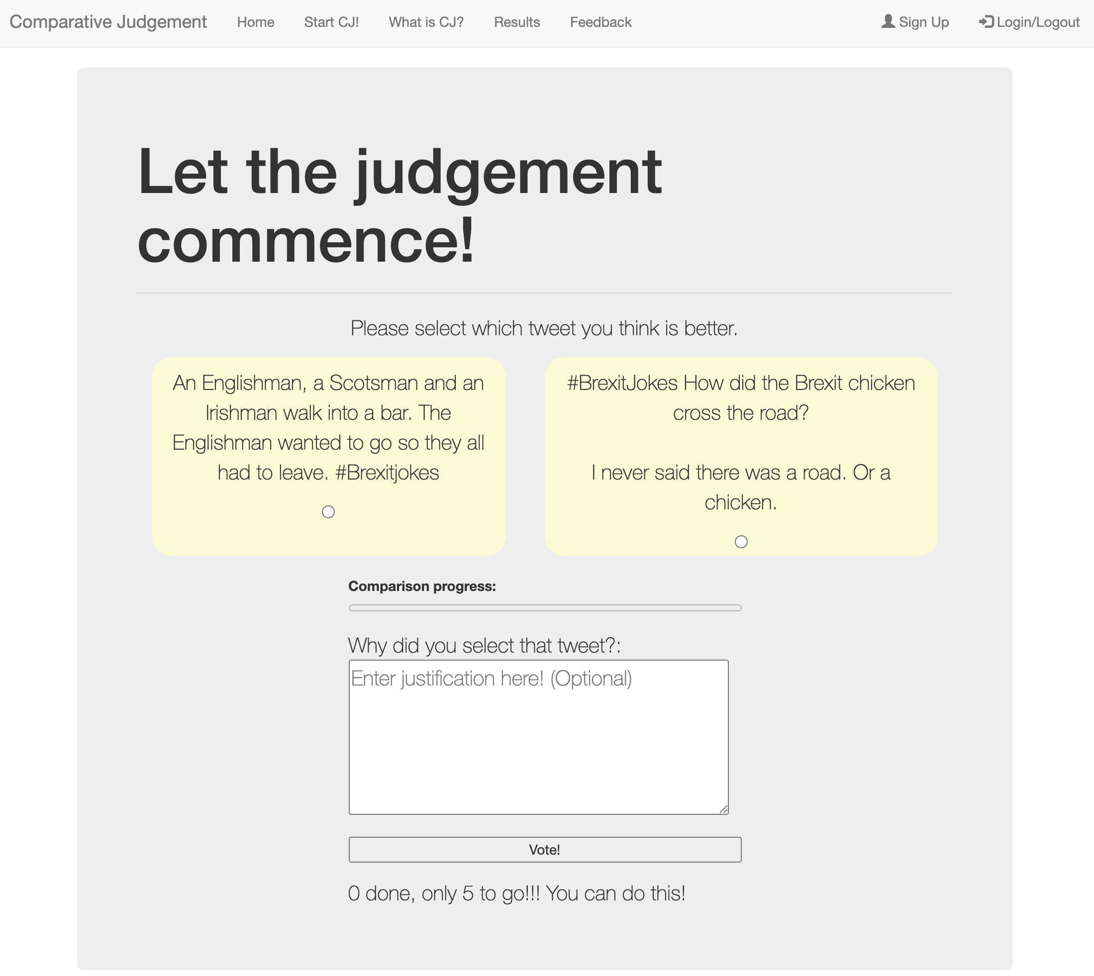
Implementation
https://comparative-judgement-web-app.herokuapp.com/

Slide 17
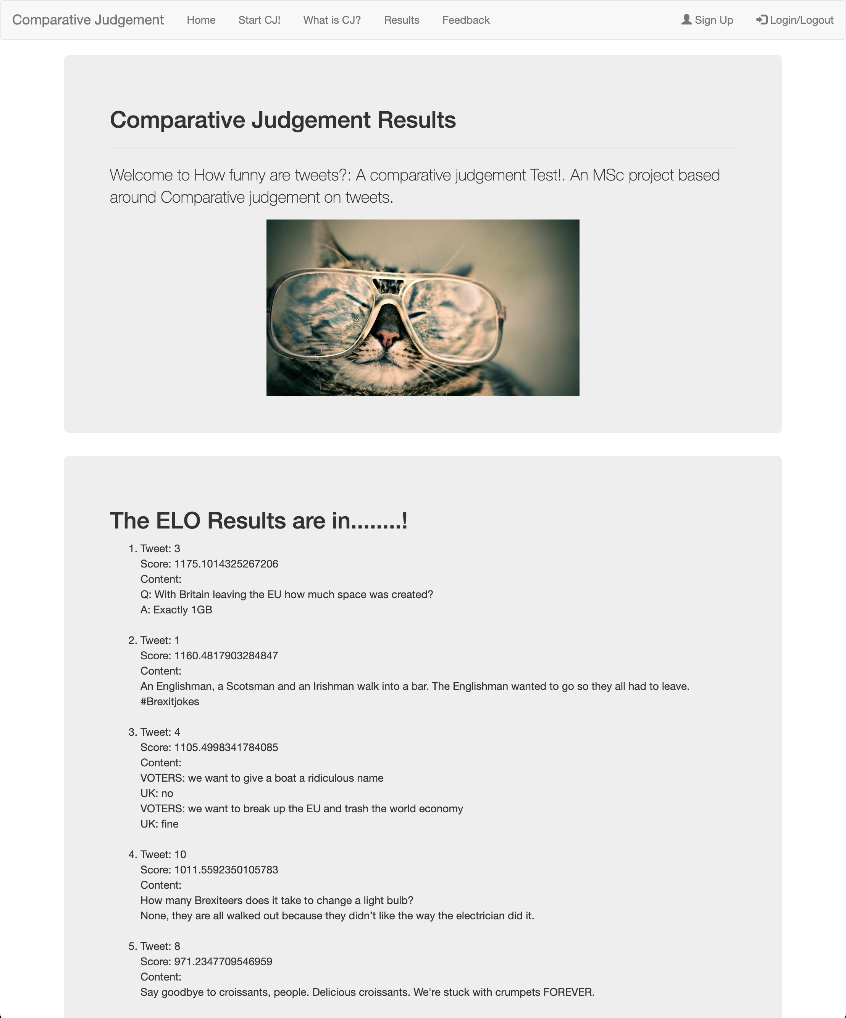
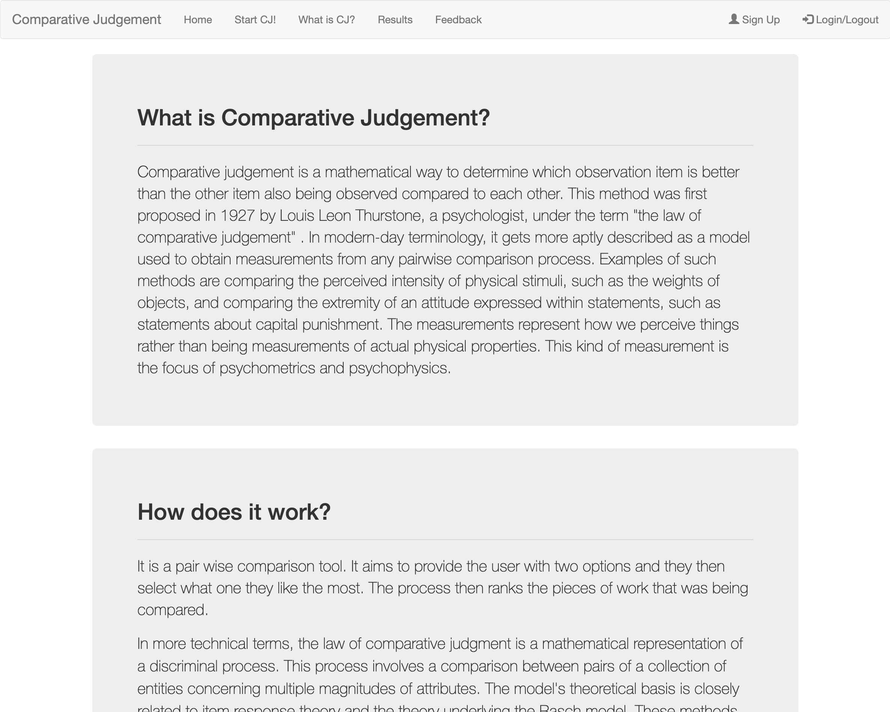
Implementation

Slide 18
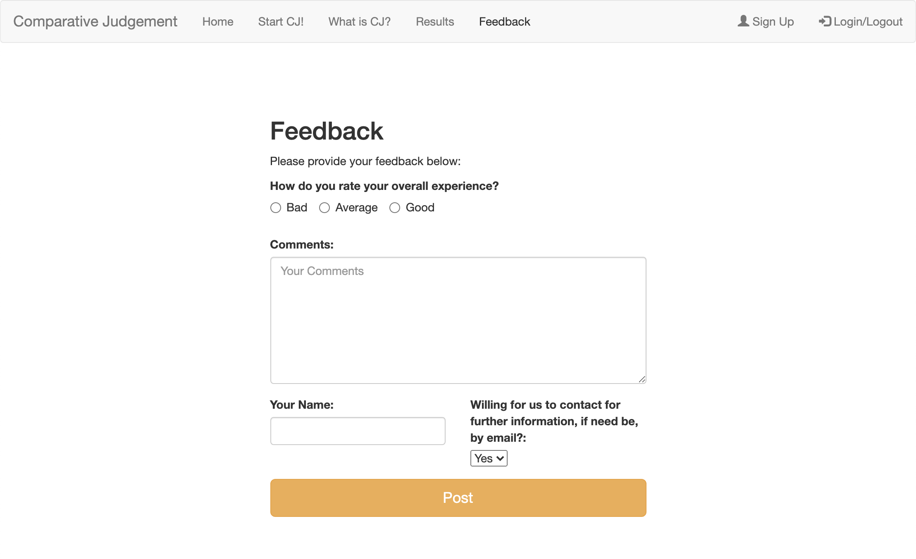
Implementation
https://comparative-judgement-web-app.herokuapp.com/

Slide 19
Overview
Motivation
Background
Methodology
Demonstration
Results
Conclusion

Slide 20
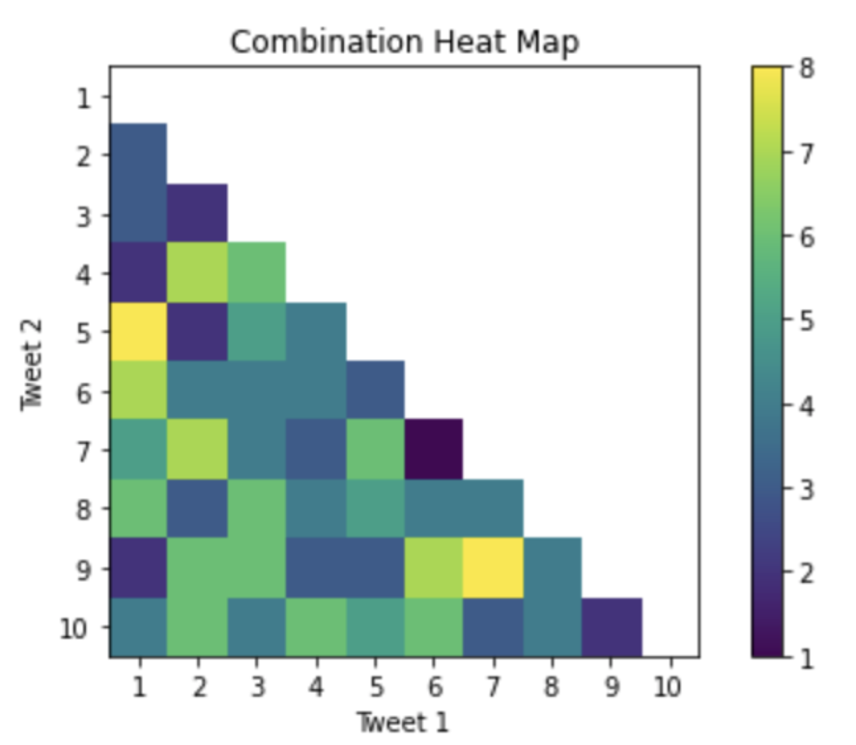
Results
40 users took part
All the tweets were used
Tweet 1 vs Tweet 5 and Tweet 7 and 9 were the highest occurring tweet combinations
Tweet combination 6 & 7 appeared the least

Slide 21
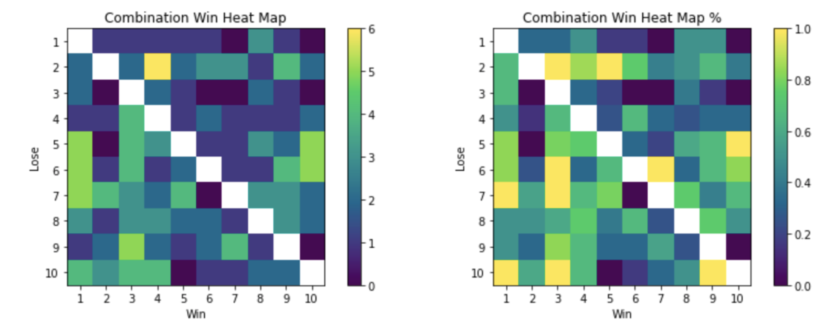
Results
10 tweet comparisons resulted in the same tweet winning 100%
Tweet 4 beat Tweet 2 the most (6-1)
Tweets 2, 5, 6, 7 & 10 had moments where they didn’t win a certain tweet
Tweets 2, 5, 6, 7 & 10 didn’t win against two tweets

Slide 22
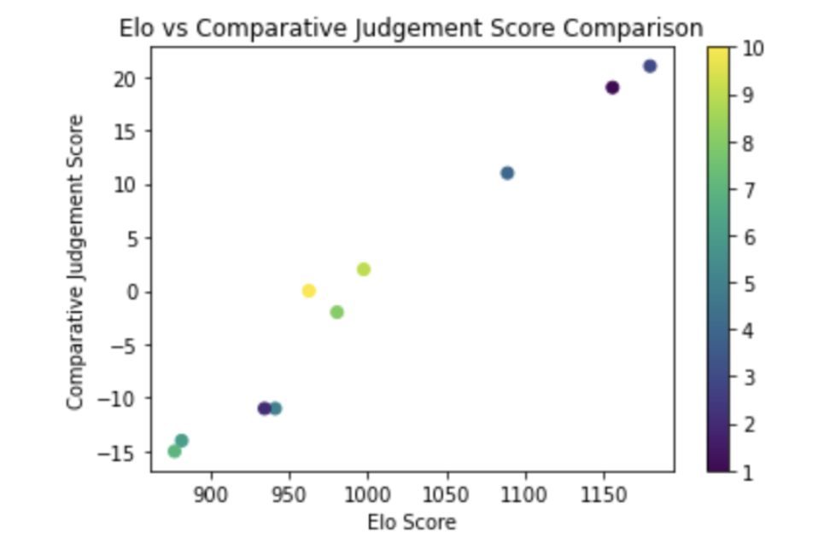
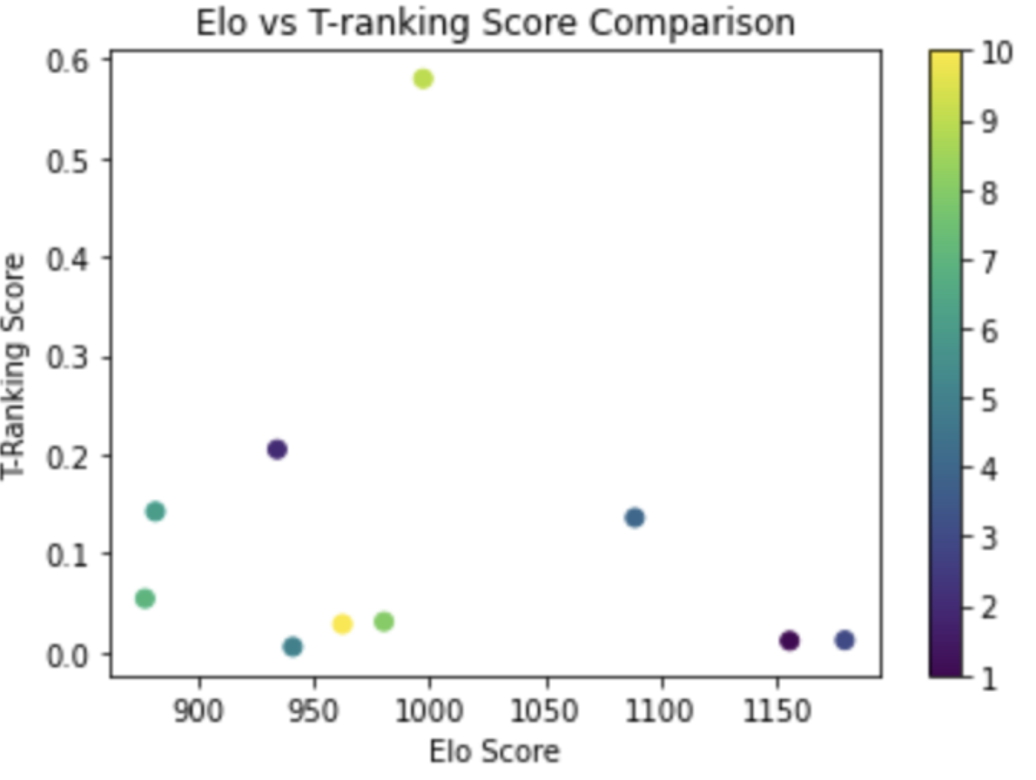
Results
Elo vs CJ
Positively correlated
Pearson's Score: 0.98391595
T-Ranking vs
Elo: -0.14360792
CJ: -0.09776676

Slide 23
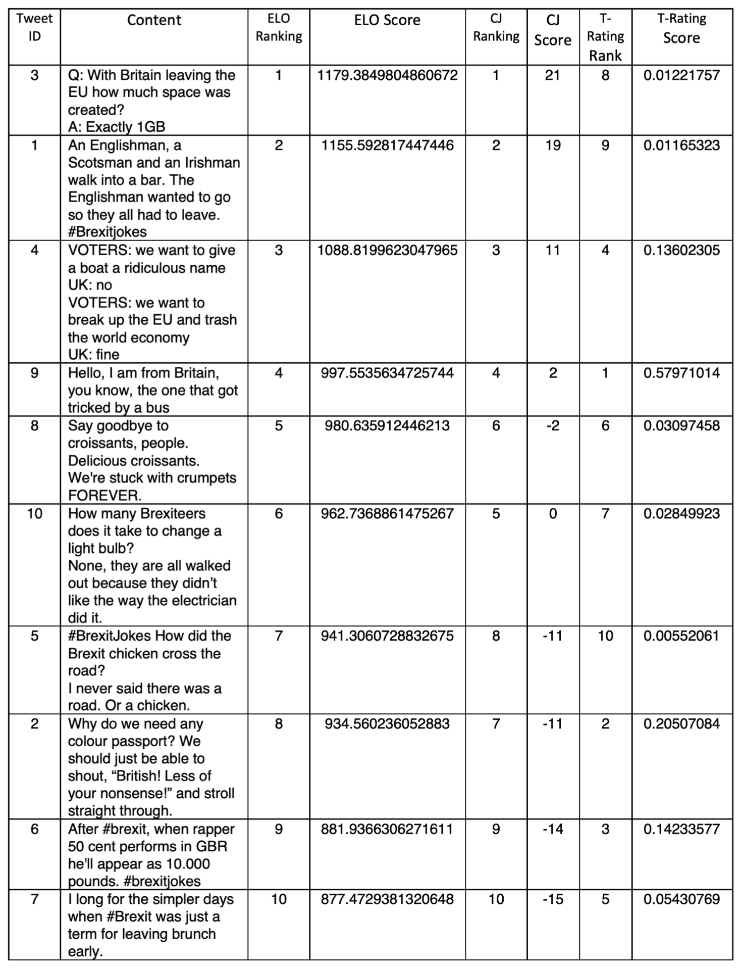
Results
Elo and CJ ranking generated very similar results.
Demonstrating that Elo can handle the random pairing well
Tweets coming in 6th, 7th, and 8th slightly vary in the results
Elo against T-rating are very different:
1st in the T-rating came 4th in the Elo ranking
1st in the Elo ranking came 8th in the T-rating
4 of the top 5 T-rating tweets were in the bottom 5 of the Elo ranking

Slide 24
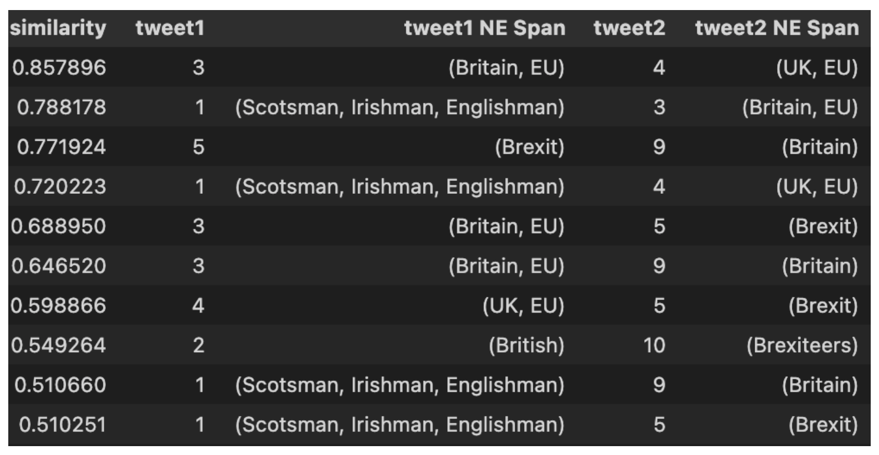
Results
Tweet 3
Q: With Britain leaving the EU how much space was created? A: Exactly 1GB”
Tweet 4
VOTERS: we want to give a boat a ridiculous name UK: no VOTERS: we want to break up the EU and trash the world economy UK: fine"

Slide 25
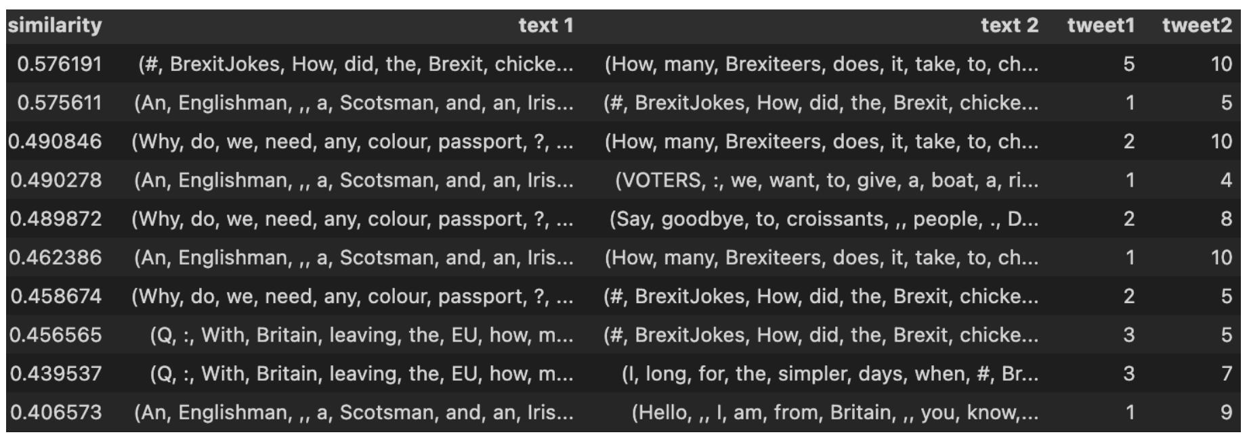
Results
Tweet 5
#BrexitJokes How did the Brexit chicken cross the road? "I never said there was a road. Or a chicken".
Tweet 10
How many Brexiteers does it take to change a light bulb? None, they are all walked out because they didn’t like the way the electrician did it.

Slide 26
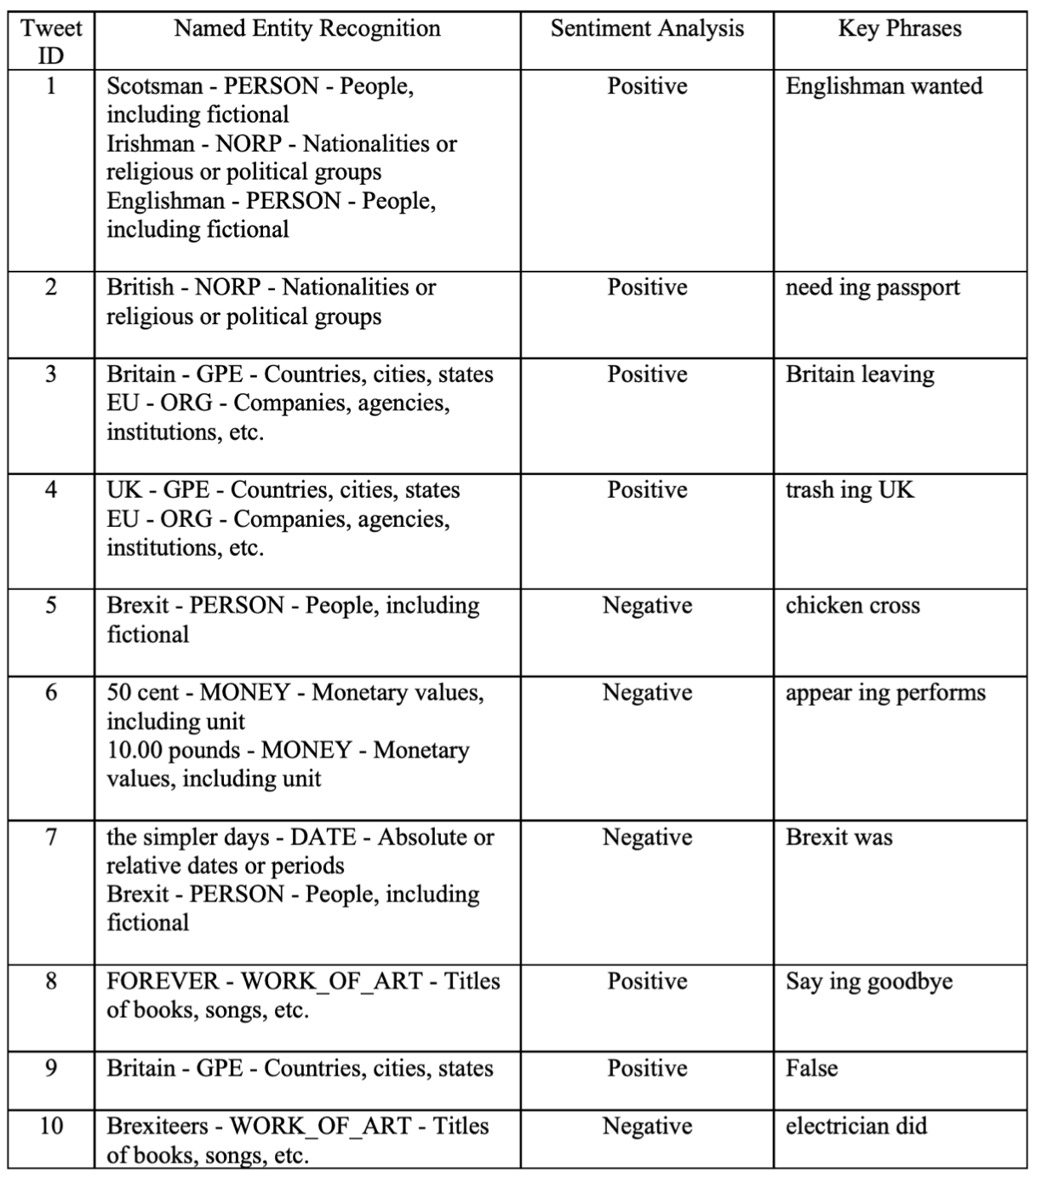
Results
6 Sentiments scoring classified as positive – 4 Negative
The key phrases provided some good insights
The POS and NER provided some good insights
3 techniques provided no meaningful insights
Notes:
6 Sentiments scoring classified as positive
5 were in the top 5 results
The key phrases provided some good insights
Apart from Tweet 7
The POS and NER provided some good insights but not enough to do anything meaningful with them currently
3 techniques provided no meaningful insights
Utterance Pattern Matching
Finding Word Sequence Patterns
Feature Extraction

Slide 27
Overview
Motivation
Background
Methodology
Implementation
Results
Conclusion

Slide 28

Conclusion
Overall, Elo seems like a good alternative to CJ
Elo was able to handle the element of random pairing well
Both the Elo and CJ score were positively correlated
The Elo system was able to remove the need for multiple judging rounds
T-ranking was negatively correlated to both Elo and CJ score
NLP created some good building blocks but no meaningful feedback at present

Slide 29

Future Work
A bigger sample pool to conduct the study on to see Elo’s effect
Converting the Elo score results to grade marks
Exploring the NLP capabilities more in providing personalised feedback
Allowing the feedback to be generated automatically

Slide 30

Questions & Answers

